Slide 1
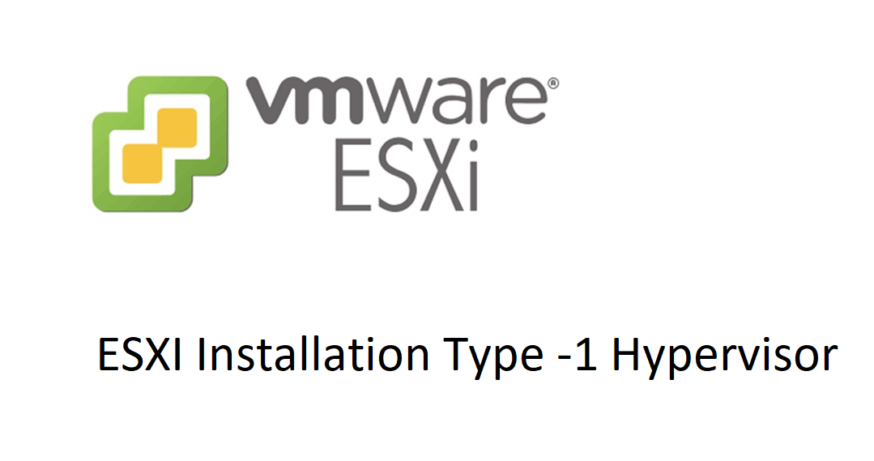

Slide 2
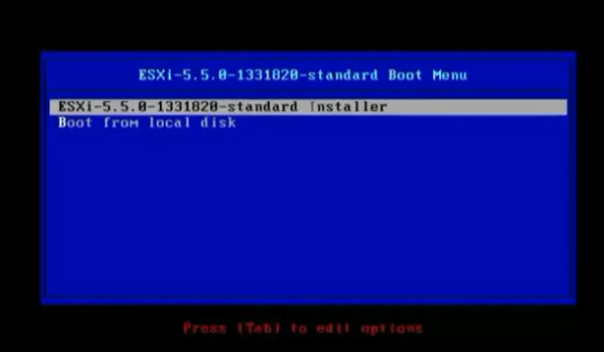
Insert Bootable USB to your Hardware machine. Select the ESXI version and press enter.

Slide 3
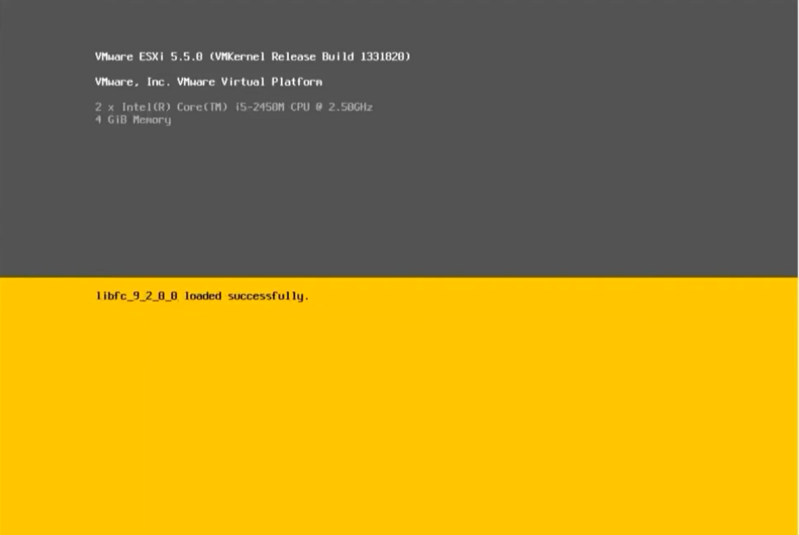
System installing drivers automatically form bootable USB.

Slide 4
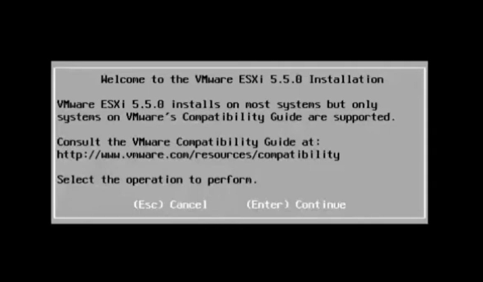
Select Enter to Continue

Slide 5
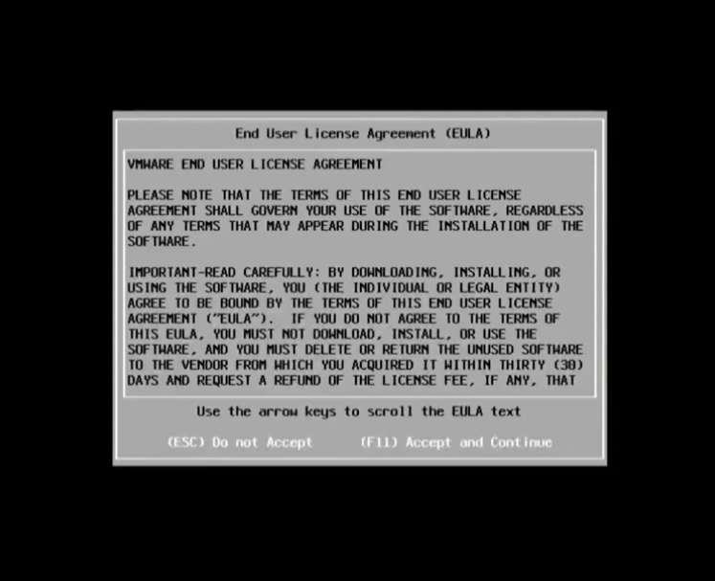
Press F11 key to Continue

Slide 6
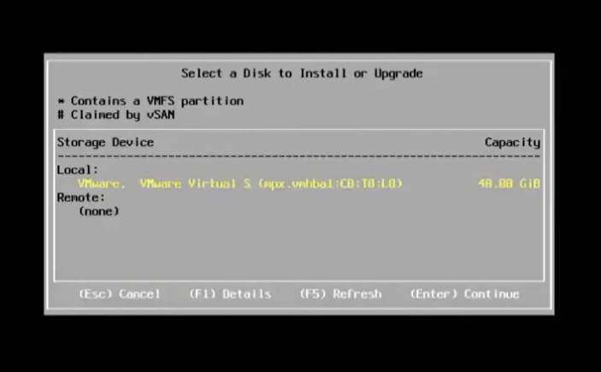
Press Enter to Continue

Slide 7
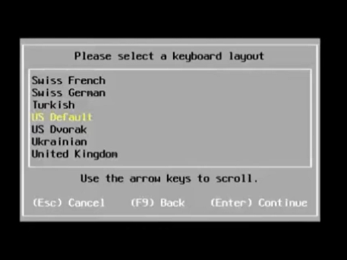
Select keyboard layout. Like US default Press Enter to Continue.

Slide 8
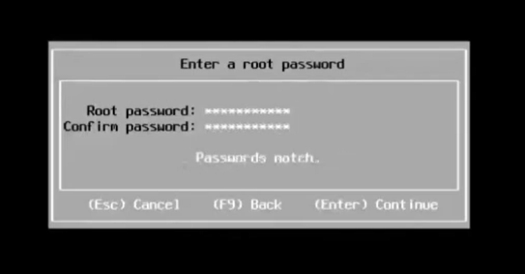
Set Root Password

Slide 9
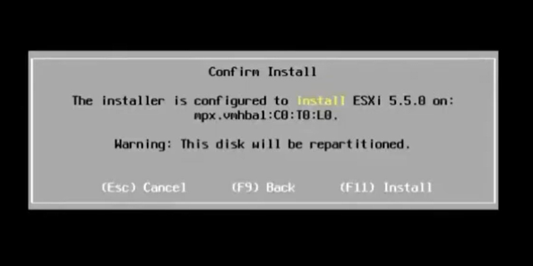
Press F 11 to install

Slide 10
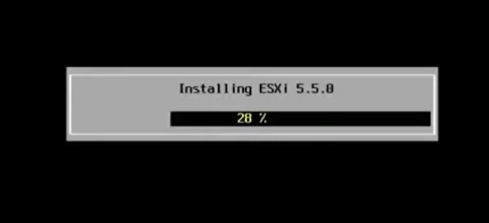
Please wait to 100% completion.

Slide 11
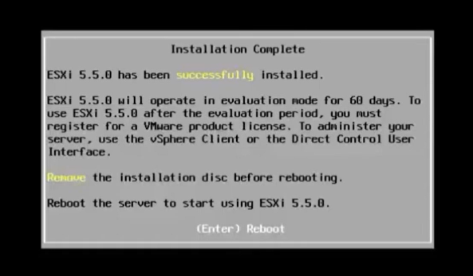
Installation complete. This is valid for 60 days only as mentioned. Now Remove the installation media and press enter to reboot

Slide 12
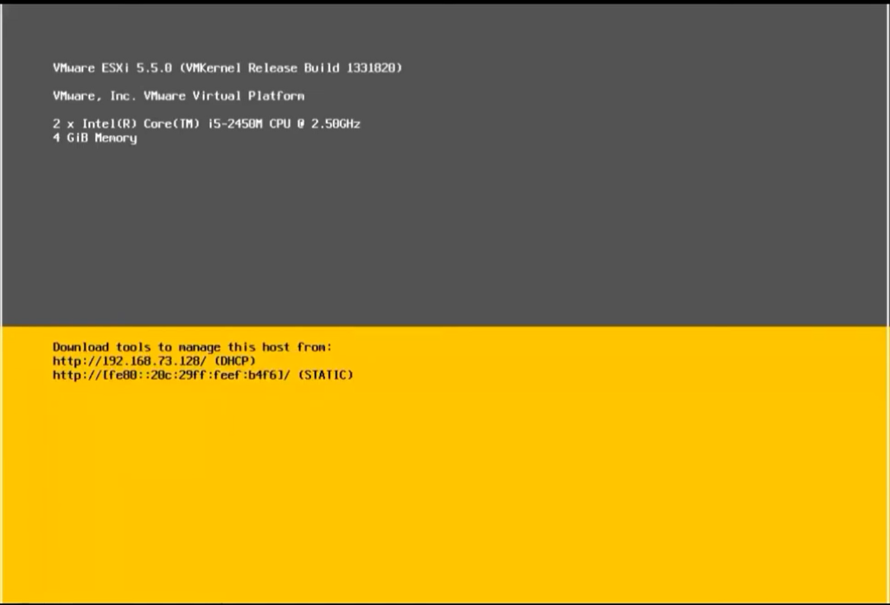
Download tools to manage this host from Web base access. Means you need another machine to access the server using browser with the help of IP address.

Slide 13
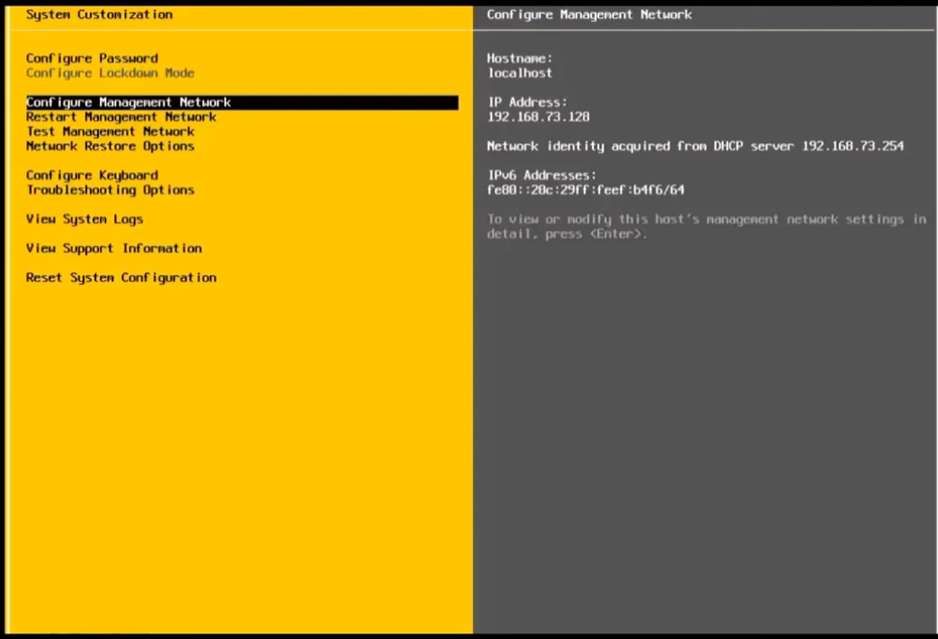
Select the Configure Management Network to set the static IP for Machine.

Slide 14
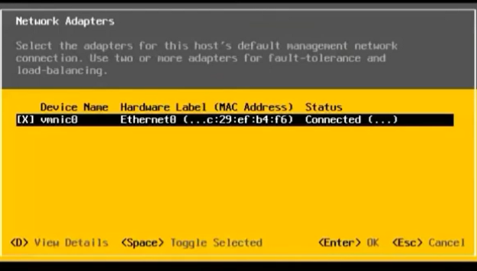
Press Enter to access the IP setting

Slide 15
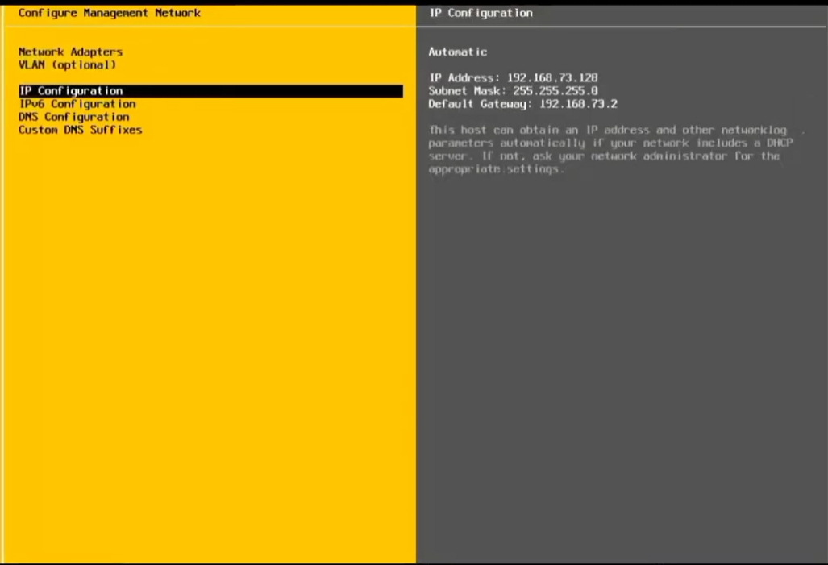
Select IP Configuration

Slide 16
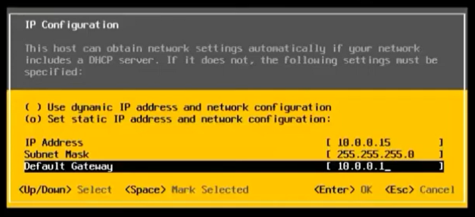
Provide IP Address, subnet mask and default gateway according to your organization pool.

Slide 17
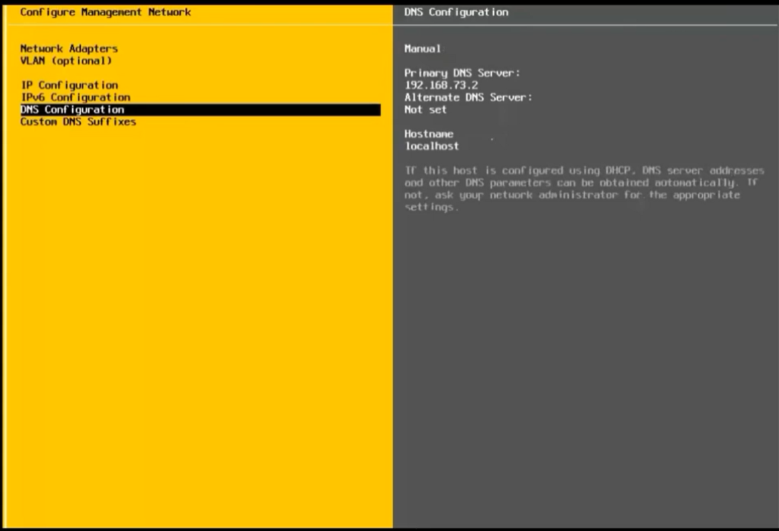
Select DNS Configuration

Slide 18
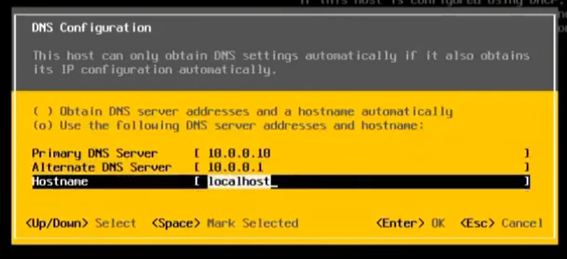
Add DNS and alternate DNS. And press enter.

Slide 19
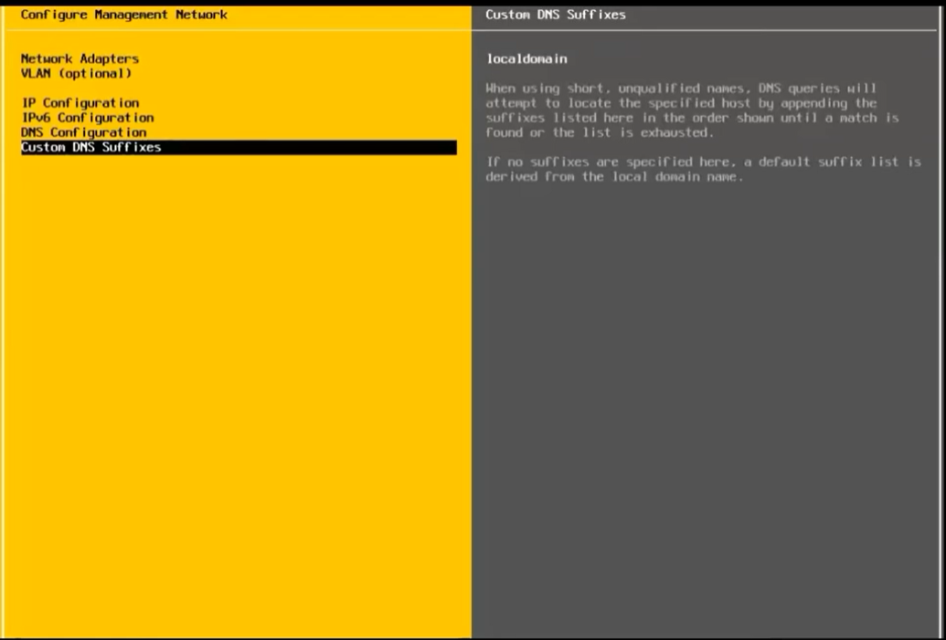
Press Esc key

Slide 20
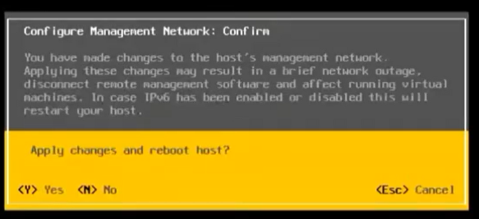
Press y to restart your machine.

